Slide 1
Introduction to Machine Learning
A Few Useful Things to Know about Machine Learning

Slide 2
Application area
Web search
Spam filters
Recommender systems.
Ad placements
Credit scoring
Fraud detection
Stock trading
Drug design

Slide 3
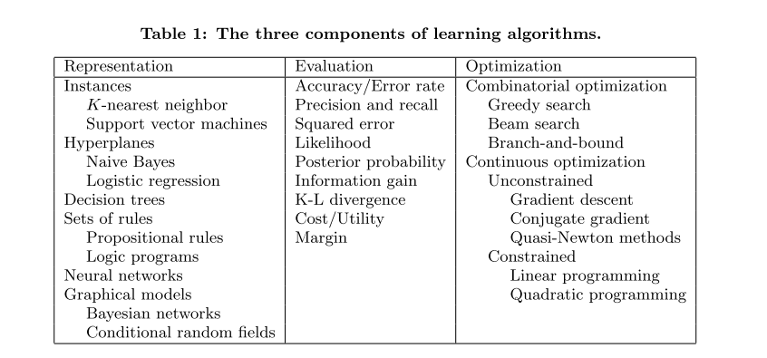
Learning = Representation + Evaluation + Optimization

Slide 4
Bewildering variety of learning algorithms ?
The key to not getting lost in this huge space is to realize that it consists of combinations of just three components. The components are:
Representation.
A classiﬁer must be represented in some formal language that the computer can handle. Con- versely, choosing a representation for a learner is tantamount to choosing the set of classiﬁers that it can possibly learn. This set is called the hypothesis space of the learner. If a classiﬁer is not in the hypothesis Space , it cannot be learned. A related question, which we will address in a later section, is how to represent the input, i.e., what features to use.

Slide 5
Bewildering variety of learning algorithms ?
Evaluation.
An evaluation function (also called objective function or scoring function) is needed to distinguish good classiﬁers from bad ones. The evaluation function used internally by the algorithm may diﬀer from the external one that we want the classiﬁer to optimize, for ease of optimization (see below) and due to the issues discussed in the next section.

Slide 6
Bewildering variety of learning algorithms ?
Optimization.
Finally, we need a method to search among the classiﬁers in the language for the highest-scoring one. The choice of optimization technique is key to the eﬃciency of the learner, and also helps determine the classiﬁer produced if the evaluation function has more than one optimum. It is common for new learners to start out using oﬀ-the-shelf optimizers, which are later replaced by custom-designed ones.

Slide 7
IT’S GENERALIZATION THAT COUNTS
The fundamental goal of machine learning is to generalize beyond the examples in the training set.
Notes:
Machine learning is not magic; it can’t get something from nothing. What it does is get more from
less. Programming, like all engineering, is a lot of work: we have to build everything from scratch. Learning is more
like farming, which lets nature do most of the work. Farm-ers combine seeds with nutrients to grow crops. Learners
combine knowledge with data to grow programs.

Slide 8
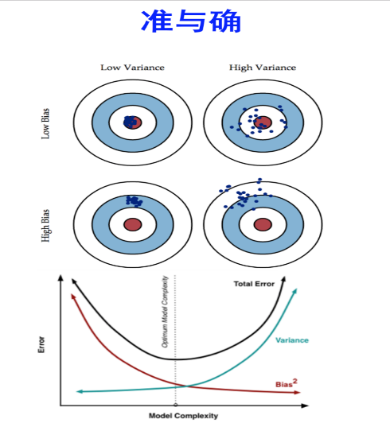
机器学习中的Bias(偏差)，Error(误差)，和Variance(方差)有什么区别和联系？
Bias is a learner’s tendency to consistently learn the same wrong thing.
Variance is the tendency to learn random things irrespective of
the real signal.
bias-variance tradeoﬀ
Notes:
Error反映的是整个模型的准确度.
Bias反映的是模型在样本上的输出与真实值之间的误差，即模型本身的精准度
Variance反映的是模型每一次输出结果与模型输出期望之间的误差，即模型的稳定性。
举一个例子，一次打靶实验，目标是为了打到10环，但是实际上只打到了7环，那么这里面的Error就是3。具体分析打到7环的原因，可能有两方面：一是瞄准出了问题，比如实际上射击瞄准的是9环而不是10环；二是枪本身的稳定性有问题，虽然瞄准的是9环，但是只打到了7环。那么在上面一次射击实验中，Bias就是1,反应的是模型期望与真实目标的差距，而在这次试验中，由于Variance所带来的误差就是2，即虽然瞄准的是9环，但由于本身模型缺乏稳定性，造成了实际结果与模型期望之间的差距。

Slide 9
How to combat overﬁtting？
Cross-validation
Adding a regularization term to the evaluation function. (This can, for example, penalize classiﬁers with more structure, thereby favoring smaller ones with less room to overﬁt.)

Slide 10
Feature Engineering
Feature engineering is more diﬃcult because it’s domain-speciﬁc.
Features that look irrelevant in isolation may be relevant in combination.
gather data, integrate it, clean it and pre-process it

Slide 11
Ensemble
Bagging: Generate random variations of the training set by resampling, learn a classiﬁer on each, and combine the results by voting.
Boosting: Training examples have weights, and these are varied so that each new classiﬁer focuses on the examples the previous ones tended to get wrong.
Stacking: the outputs of individual classiﬁers become the inputs of a “higher-level” learner that ﬁgures out how best to combine them.

Slide 12
Classification
A classiﬁer is a system that inputs (typically) a vector of discrete and/or continuous feature values and outputs a single discrete value, the class.
Notes:
For example, a spam ﬁlter classiﬁes email messages into“spam”or“not spam,” and its input may be a Boolean vector x = (x 1 , . . . , x j , . . . , x d ), where x j = 1 if the jth word in the dictionary appears in the email and x j = 0 otherwise. A learner inputs a training set of exam- ples (x i , y i ), where x i = (x i,1 , . . . , x i,d ) is an observed input and y i is the corresponding output, and outputs a classiﬁer. The test of the learner is whether this classiﬁer produces the correct output y t for future examples x t (e.g., whether the spam ﬁlter correctly classiﬁes previously unseen emails as spam or not spam).

Slide 13
Why are you here?
What is Machine Learning?
Why are you taking this course?
What topics would you like to see covered?

Slide 14

Machine Learning is…
Machine learning, a branch of artificial intelligence, concerns the construction and study of systems that can learn from data.

Slide 15
Machine Learning is…
Machine learning is programming computers to optimize a performance criterion using example data or past experience.
-- Ethem Alpaydin
The goal of machine learning is to develop methods that can automatically detect patterns in data, and then to use the uncovered patterns to predict future data or other outcomes of interest.
-- Kevin P. Murphy
The field of pattern recognition is concerned with the automatic discovery of regularities in data through the use of computer algorithms and with the use of these regularities to take actions.
-- Christopher M. Bishop

Slide 16
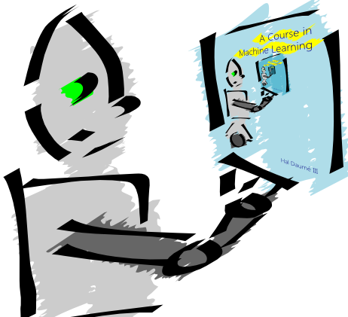
Machine Learning is…
Machine learning is about predicting the future based on the past.
-- Hal Daume III

Slide 17
Machine Learning is…
Machine learning is about predicting the future based on the past.
-- Hal Daume III
past
future
predict
learn
Training
Data
model/
predictor
Testing
Data
model/
predictor

Slide 18
Machine Learning, aka
data mining: machine learning applied to “databases”, i.e. collections of data
inference and/or estimation in statistics
pattern recognition in engineering
signal processing in electrical engineering
induction
optimization

Slide 19
Goals of the course: Learn about…
Different machine learning problems
Common techniques/tools used
theoretical understanding
practical implementation
Proper experimentation and evaluation
Dealing with large (huge) data sets
Parallelization frameworks
Programming tools

Slide 20
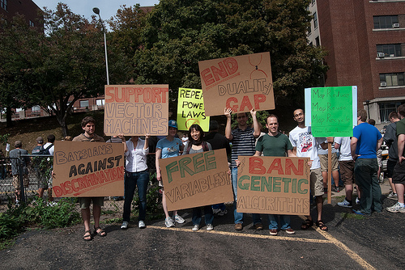
Goals of the course
Be able to laugh at these signs
(or at least know why one might…)

Slide 21
Administrative
Course page:
http://www.cs.middlebury.edu/~dkauchak/classes/cs451/
go/cs451
Assignments
Weekly
Mostly programming (Java, mostly)
Some written/write-up
Generally due Friday evenings
Two exams
Late Policy
Honor code

Slide 22
Course expectations
400-level course
Plan to stay busy!
Applied class, so lots of programming
Machine learning involves math

Slide 23
Machine learning problems
What high-level machine learning problems have you seen or heard of before?

Slide 24

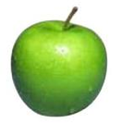


Data
examples
Data

Slide 25

Data
examples
Data

Slide 26

Data
examples
Data

Slide 27



Data
examples
Data

Slide 28
Supervised learning
examples
label
label₁
label₃
labeled examples
label₄
label₅
Supervised learning: given labeled examples

Slide 29
Supervised learning
label
label₁
model/
predictor
label₃
label₄
label₅
Supervised learning: given labeled examples

Slide 30
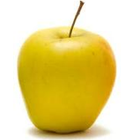
Supervised learning
model/
predictor
predicted label
Supervised learning: learn to predict new example

Slide 31
Supervised learning: classification
label
apple
Classification: a finite set of labels
apple
banana
banana
Supervised learning: given labeled examples

Slide 32
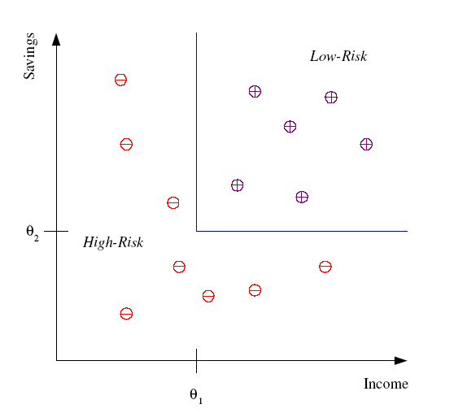
Classification Example
Differentiate between low-risk and high-risk customers from their income and savings

Slide 33
Classification Applications
Face recognition
Character recognition
Spam detection
Medical diagnosis: From symptoms to illnesses
Biometrics: Recognition/authentication using physical and/or behavioral characteristics: Face, iris, signature, etc
...

Slide 34
Supervised learning: regression
label
-4.5
Regression: label is real-valued
10.1
3.2
4.3
Supervised learning: given labeled examples

Slide 35
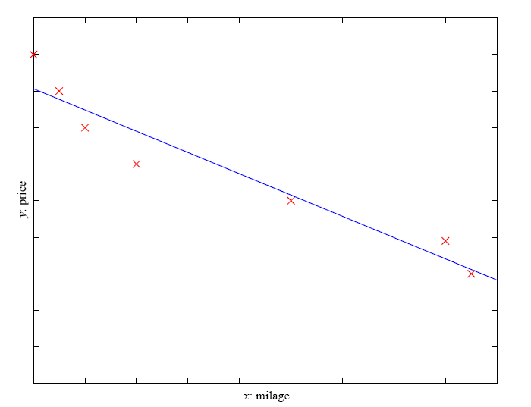
Regression Example
Price of a used car
x : car attributes (e.g. mileage)
y : price
y = wx+w₀

Slide 36
Regression Applications
Economics/Finance: predict the value of a stock
Epidemiology
Car/plane navigation: angle of the steering wheel, acceleration, …
Temporal trends: weather over time
…

Slide 37
Supervised learning: ranking
label
1
Ranking: label is a ranking
4
2
3
Supervised learning: given labeled examples

Slide 38
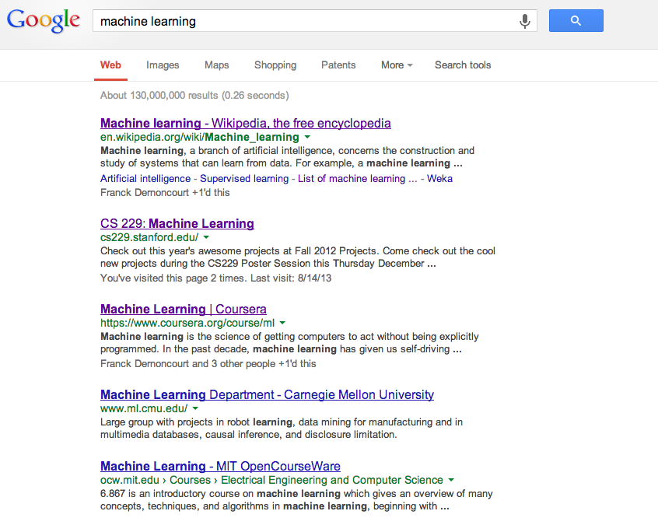
Ranking example
Given a query and
a set of web pages,
rank them according
to relevance

Slide 39
Ranking Applications
User preference, e.g. Netflix “My List” -- movie queue ranking
iTunes
flight search (search in general)
reranking N-best output lists
…

Slide 40
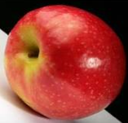
Unsupervised learning
Unupervised learning: given data, i.e. examples, but no labels

Slide 41
Unsupervised learning applications
learn clusters/groups without any label
customer segmentation (i.e. grouping)
image compression
bioinformatics: learn motifs
…

Slide 42
Reinforcement learning
left, right, straight, left, left, left, straight
GOOD
left, straight, straight, left, right, straight, straight
BAD
left, right, straight, left, left, left, straight
18.5
left, straight, straight, left, right, straight, straight
-3
Given a sequence of examples/states and a reward after completing that sequence, learn to predict the action to take in for an individual example/state

Slide 43
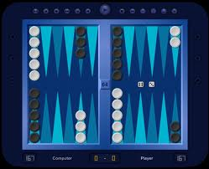
Reinforcement learning example
Backgammon
…
WIN!
…
LOSE!
Given sequences of moves and whether or not the player won at the end, learn to make good moves

Slide 44

Reinforcement learning example
http://www.youtube.com/watch?v=VCdxqn0fcnE

Slide 45
Other learning variations
What data is available:
Supervised, unsupervised, reinforcement learning
semi-supervised, active learning, …
How are we getting the data:
online vs. offline learning
Type of model:
generative vs. discriminative
parametric vs. non-parametric

